Slide 1
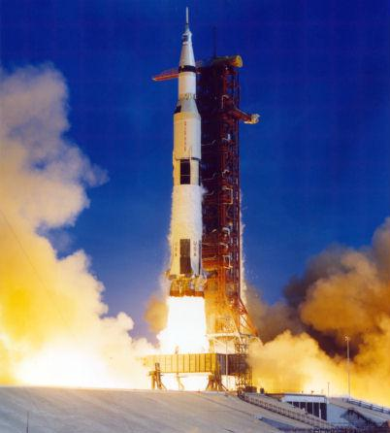
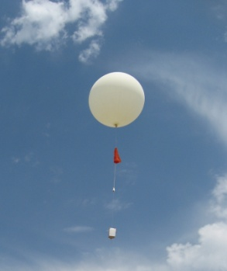
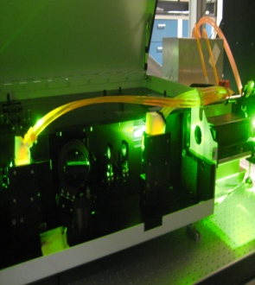
Why are TOLNet and NDACC Here Today?
TOLNET
ECCC
ARC
ESRL
GSFC
JPL
LaRC
UAH
5th Annual TOLNet Meeting 7-8 May 2017
1st Joint TOLNet & NDACC Meeting 8-9 May 2017
Huntsville, Alabama, USA
8 May, 2018
Mike Newchurch
University of Alabama in Huntsville
https://www-air.larc.nasa.gov/missions/TOLNet/
http://ndacc-lidar.org/

Slide 2
TOLNET & NDACC
ECCC
ARC
ESRL
GSFC
JPL
LaRC
UAH
NDACC Lidar Working Group Mission:
While the NDACC remains committed to monitoring changes in the stratosphere with an emphasis on the long-term evolution of the ozone layer, its priorities have broadened considerably to encompass issues such as the detection of trends in overall atmospheric composition and understanding their impacts on the stratosphere and troposphere, and establishing links between climate change and atmospheric composition.
To ensure quality and consistency of the NDACC lidars operation and products, a number of protocols have been formulated covering such topics as validation, measurements and instruments intercomparisons, and theory and analysis. The members of the NDACC Lidar Working Group (LWG) are committed to follow the principles of these protocols, and the LWG meets every two years to review and coordinate the activities necessary to the valuable contribution of the lidars to NDACC.
5th Annual TOLNet Meeting 7-8 May 2017, Huntsville, AL USA
1st Joint TOLNet & NDACC Meeting 8-9 May 2017, Huntsville, AL USA

Slide 3
TOLNET & NDACC
ECCC
ARC
ESRL
GSFC
JPL
LaRC
UAH
TOLNet Mission:
The primary scientific objective is to provide time/height ozone measurements from near the surface to the top of the troposphere to describe in high-fidelity their spatio-temporal distribution for use by TEMPO and other space-borne instruments to understand the PBL and FT ozone structures.
The second focus resides in basic scientific research into the processes creating and destroying the ubiquitously observed ozone laminae, STE, local ozone exceedances, land/sea interactions, and other PBL & FT ozone structures.
A third objective is to identify a brassboard ozone lidar instrument that would be suitable to populate a network to address the needs of NASA/EPA/NOAA air-quality scientists and managers who increasingly express a desire for ozone profiles.
5th Annual TOLNet Meeting 7-8 May 2017, Huntsville, AL USA
1st Joint TOLNet & NDACC Meeting 8-9 May 2017, Huntsville, AL USA

Slide 4
Common Interests
ECCC
ARC
ESRL
GSFC
JPL
LaRC
UAH
Current Common interests
Satellite validation
Theory and Analysis
Instrument Accuracy Assessment
Consider these Potential Common Interests
STE
Tropospheric Structure and Evolution
PBL
Air Quality observations
Mobile Systems
5th Annual TOLNet Meeting 7-8 May 2017, Huntsville, AL USA
1st Joint TOLNet & NDACC Meeting 8-9 May 2017, Huntsville, AL USA

Slide 5
Considerations
ECCC
ARC
ESRL
GSFC
JPL
LaRC
UAH
NDACC is experiencing an evolution from purely stratospheric observations to also measuring tropospheric structures.
Modify or augment stratospheric systems (e.g., TMF or GSFC).
Or focus on only tropospheric observations (e.g., HSV).
Geostationary satellites (GEMS, TEMPO, Sentinel 4) form an international constellation of Stratospheric & tropospheric instruments with a common scientific formulation: CEOS Atmospheric Composition – Virtual Constellation: http://ceos.org/meetings/ac-vc-14/. NDACC could evolve to integrate with these Geo platforms.
5th Annual TOLNet Meeting 7-8 May 2017, Huntsville, AL USA
1st Joint TOLNet & NDACC Meeting 8-9 May 2017, Huntsville, AL USA

Slide 6
Quo Vadis?
ECCC
ARC
ESRL
GSFC
JPL
LaRC
UAH
What are your thoughts?
5th Annual TOLNet Meeting 7-8 May 2017, Huntsville, AL USA
1st Joint TOLNet & NDACC Meeting 8-9 May 2017, Huntsville, AL USA

Slide 7
TOLNET
ECCC
ARC
ESRL
GSFC
JPL
LaRC
UAH
1.
5th Annual TOLNet Meeting 7-8 May 2017, Huntsville, AL USA
1st Joint TOLNet & NDACC Meeting 8-9 May 2017, Huntsville, AL USA

